Slide 1
One Year of Digital Aviation Services (DAS)
Roger Martin and Jason Anglin
NWS Wichita / NWS Great Falls

Slide 2
Successes

Slide 3
Successes
Quick TAF creation
Focus on targets of opportunity
Target of opportunity
Let models/DAS handle
Notes:
Quick TAF creation ⇒ during busy/active weather. Helps with last-minute issuance if needed
Focus on targets of opportunity ⇒ The NWS continues to move more towards the concept of finding where we can add the most value. TSRA is an example. DAS does reasonably well in less-impactful periods

Slide 4
Successes
Flexibility with shift duties
DSS
Research
Training
One Forecaster
Other Forecasters
Notes:
Flexibility with shift duties ⇒ Follows the “Blue-sky initiative” where one forecaster takes all forecasting, including aviation, and others can work on outreach, DSS, etc.

Slide 5
Successes
It is usable in mountain offices
Trust me, I’m a Meteorologist...
Output can alert forecasters to possible impacts
LLWS, lower than expected CIGs, etc

Slide 6
Successes
Consistency between public and aviation forecasts
Public Forecast Grids
DAS Grids
TAFs
Notes:
Consistency is important among our products. DAS is a part of increasing consistency

Slide 7
Struggles and Recommendations

Slide 8
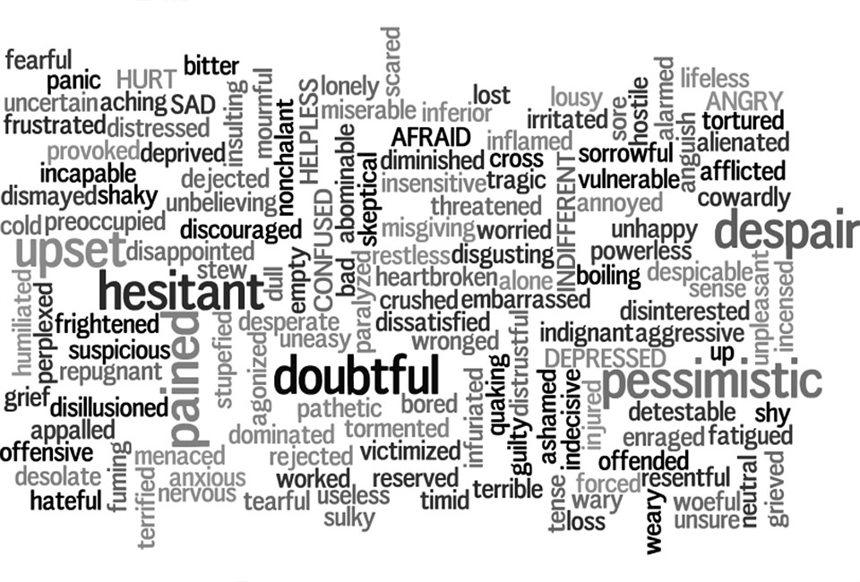
Struggle – Getting 100% Buy-in
Notes:
Change isn’t always easy or readily received. Many thoughts come to mind. How can we address some of these?

Slide 9
Recommendation
Encourage testing and feedback…and be patient
Consider an experimental / feedback period
Local Experimental Phase
Feedback
Compare output with expectations
Test tools
Local / National Changes
Concerns
Errors
Ways to improve
Problem spreadsheet (opportunity to track progress of issues)
Some localization possible (can be tailored to better serve local aviation partners)
Feedback important
Notes:
Give people a chance to voice their opinion. Better to test now than before it is mandated. Help forecasters to see that local feedback can ultimately trickle up national changes (better for WFOs and partners)

Slide 10
Struggle – Formatter Issues
Notes:
The formatter isn’t perfect and output like this may be seen

Slide 11
Recommendation
Provide feedback
Local configuration possible
Don’t expect perfection
QC required (even on quiet days)
QC doesn’t have to take long
Notes:
Again, goes back to the importance of feedback so developers can adjust output. Local changes can help with this as well. Some QC may be needed, but DAS can still save time

Slide 12
Struggle - DAS Tools
Misunderstanding/confusion with DAS tools and methodologies
Important to use tools for what they were designed for, otherwise result will be frustrating and/or not effective
Notes:
A wrench could ultimately help get a nail hammered in, but why not use a more efficient tool? Know which tools to use and in which patterns they are best utilized

Slide 13
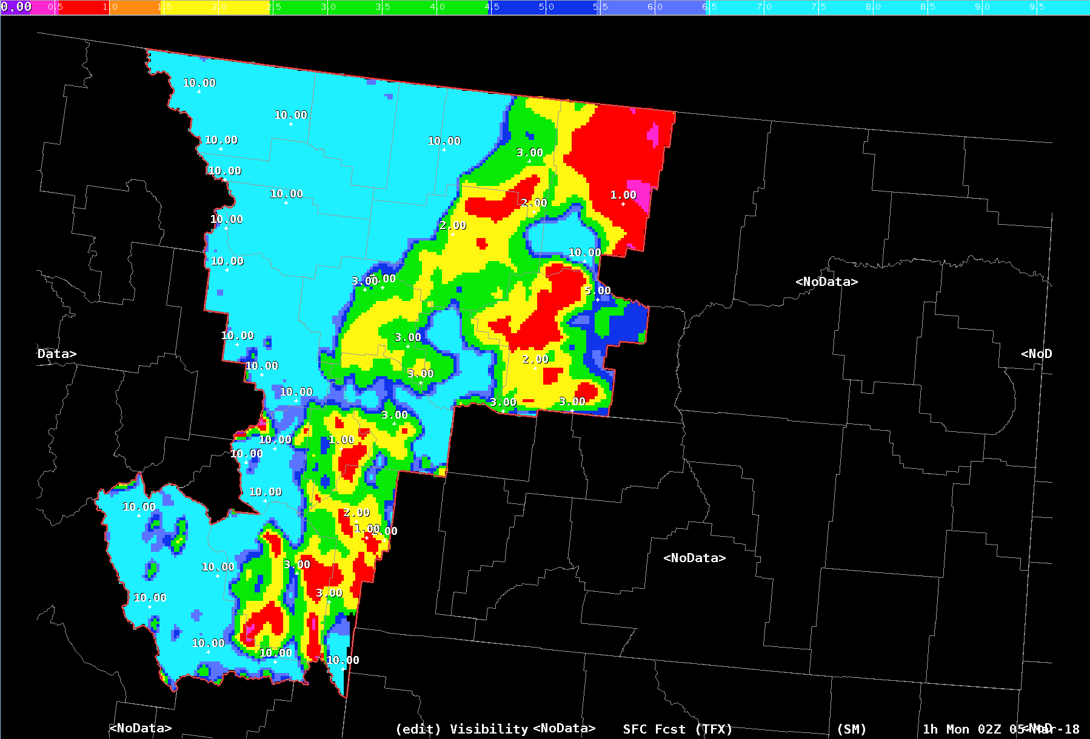
Struggle - DAS Tools
QC checks sometimes worsen output / grids
Notes:
One example of using a tool improperly is a QC check with snow.

Slide 14
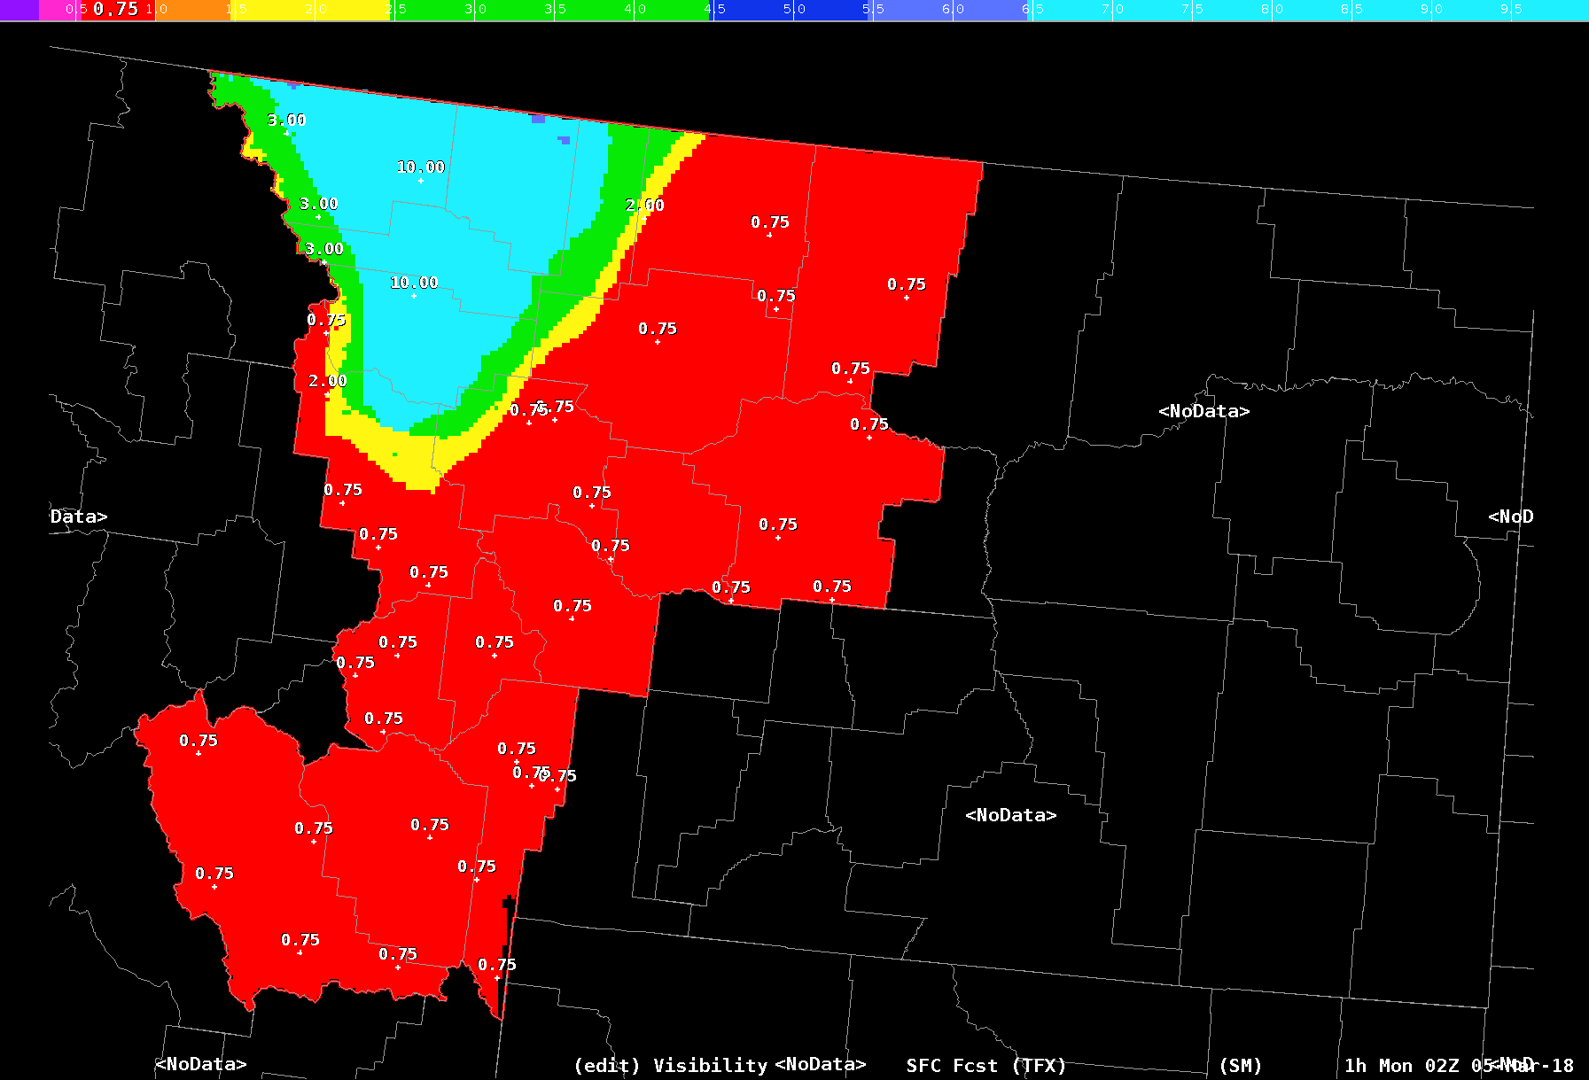
Struggle - DAS Tools
QC checks sometimes worsen output / grids
Notes:
The way the check works, it makes every location with SN in the forecast change to 3/4SM VIS, which probably isn’t the best service. QC is not only important with the formatter, but also with the grids. Disclaimer: with continued updates/improvements, some of these issues may be fixed by the time of this presentation

Slide 15
Recommendation
Create local cheat sheets/one pagers
Nationally-created ones available
VLAB ⇒ https://vlab.ncep.noaa.gov/web/cr-das
Program leaders/AFPs ⇒ Have an office lunch-and-learn
Experiment with tools in AWIPS “Practice Mode”
Notes:
You can make local cheat sheets and/or use national ones. There is also some good info on the VLAB. For some, it can be helpful to see DAS in action, so to speak, and a lunch-and-learn or one-on-one instruction could prove more helpful. Practice mode can be really helpful to run through various tools and scenarios to see how the TAF output changes

Slide 16
Recommendation
Know which QC tools to use and when

Slide 17
Struggle – Lack of Consistency
Public Forecaster
Aviation Forecaster
Notes:
As mentioned earlier in the presentation, consistency is important among our products. Being flexible with shift duties is good, but there isn’t a one-size-fits-all breakout of duties. There may be times when the public and aviation forecasts are done by different people (winter weather, severe weather, fire weather, etc), which can make a lack of consistency more possible.

Slide 18
Recommendation
Communicate
Rethink forecast duties (experiment)
Notes:
Consistency can still be achieved, but forecasters may need to be intentional about coordinating internally

Slide 19
Struggle – Partner Confusion
Some less/never-used elements may appear more with DAS
PROB30
LLWS
Notes:
Interestingly, at TFX we found that not all elements of the TAF were understood or widely used (Raleigh example).

Slide 20
Recommendation
Local outreach
Great Falls office ➔ gave presentations to local users
Request feedback
Raleigh Office ➔ formatter output adjusted to match partner feedback
PROB30
Jason Anglin
Notes:
To help with confusion, we (TFX) did some presentations for local FAA partners. And, by we, I mean Jason. Jason was very instrumental in this outreach venture. Another option is to do what RAH did and to locally adjust the TAF output to better meet partner needs

Slide 21
Struggle – Guidance in Valleys
Some guidance less useful in valleys, especially smaller valleys
More coarse resolution
Notes:
As can be expected, some model guidance cannot resolve mountain valleys as well, making the output less useful at times.

Slide 22
Recommendation
Use higher-resolution guidance
A little more QC/hand-editing may be required
Notes:
Guidance continues to improve, but what you use in your valleys may need to be different than areas that are better resolved, terrain-wise. At the end of the day, valley terminals may simply require extra QC at times

Slide 23
Final Recommendations

Slide 24
Recommendation – Backup Offices
Make sure backup offices have tools/configuration files
Don’t forget tertiary offices!
Notes:
Until every office in your region is using DAS, be mindful of backup operations and how those backup offices may need to handle aviation.

Slide 25
Questions??

Slide 26
Future Questions…
Roger Martin ➔ roger.martin@noaa.gov
Jason Anglin ➔ jason.anglin@noaa.gov
Notes:
Whether your office has already made the transition or is about to, please don’t hesitate to reach out to Jason or I if you think of other questions down the road!

